Slide 1
Principle of RSRG for Boundary Spectrum

Slide 2
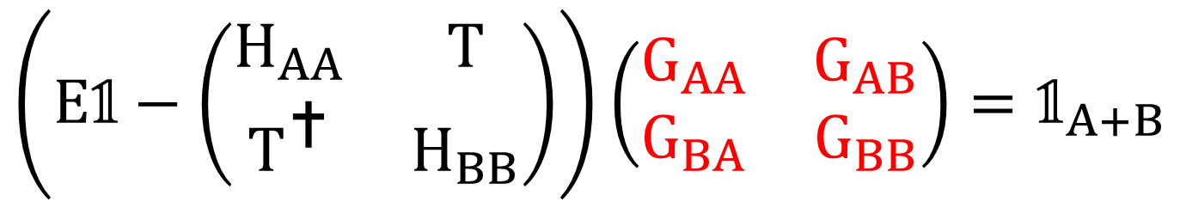
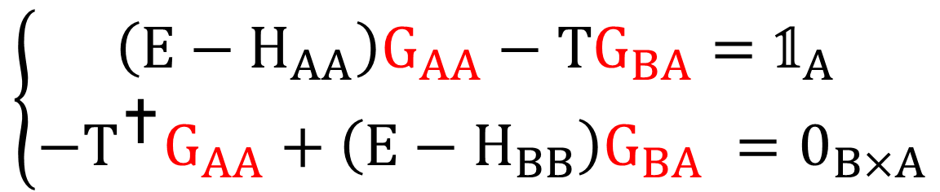
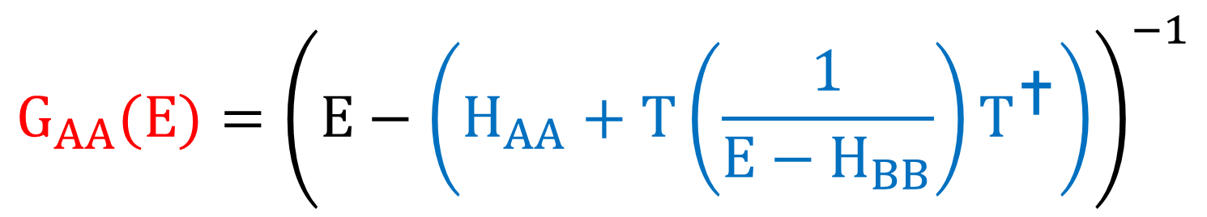
$$\left(E𝟙−\left(\begin{matrix}H_{AA} & T \\ T^{} & H_{BB}\end{matrix}\right)\right)\left(\begin{matrix}G_{AA} & G_{AB} \\ G_{BA} & G_{BB}\end{matrix}\right)=𝟙_{A+B}$$
$$\left\{\begin{aligned}\left(E−H_{AA}\right)G_{AA}−TG_{BA}=𝟙_{A} \\ −T^{}G_{AA}+\left(E−H_{BB}\right)G_{BA} =0_{B×A}\end{aligned}\right.$$
$$G_{AA}(E)={\left(E−\left(H_{AA}+T\left(\frac{1}{E−H_{BB}}\right)T^{}\right)\right)}^{−1}$$

Slide 3
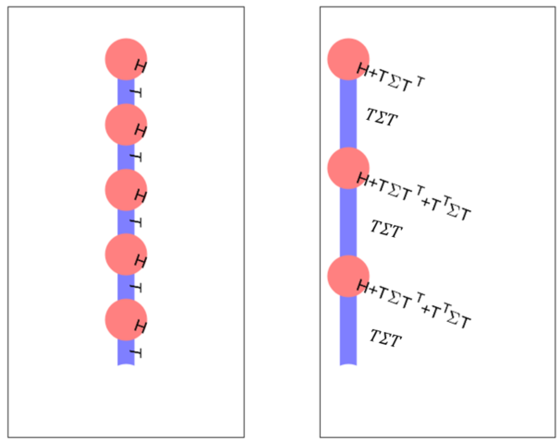
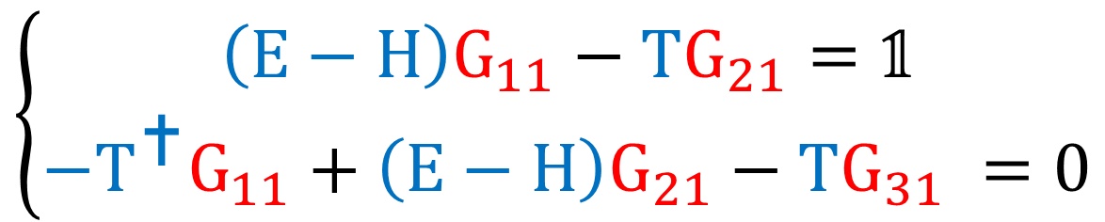
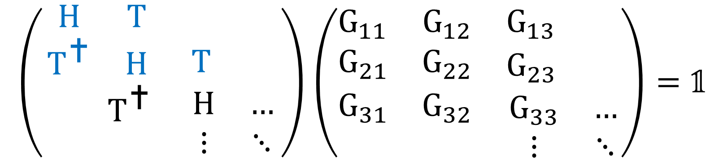
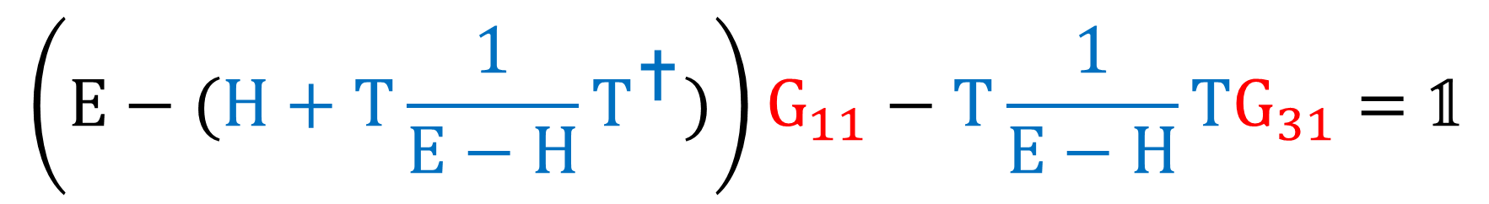
$$\left(\begin{matrix}\begin{matrix}H & T \\ T^{} & H\end{matrix} & \begin{matrix} & \\ T & \end{matrix} \\ \begin{matrix} & T^{} \\ & \end{matrix} & \begin{matrix}H & … \\ ⋮ & ⋱\end{matrix}\end{matrix}\right)\left(\begin{matrix}\begin{matrix}G_{11} & G_{12} \\ G_{21} & G_{22}\end{matrix} & \begin{matrix}G_{13} & \\ G_{23} & \end{matrix} \\ \begin{matrix}G_{31} & G_{32} \\ & \end{matrix} & \begin{matrix}G_{33} & … \\ ⋮ & ⋱\end{matrix}\end{matrix}\right)=𝟙$$
$$\left\{\begin{aligned}\left(E−H\right)G_{11}−TG_{21}=𝟙 \\ −T^{}G_{11}+\left(E−H\right)G_{21}−TG_{31} =0\end{aligned}\right.$$
$$\left(E−(H+T\frac{1}{E−H}T^{})\right)G_{11}−T\frac{1}{E−H}TG_{31}=𝟙$$

Slide 4
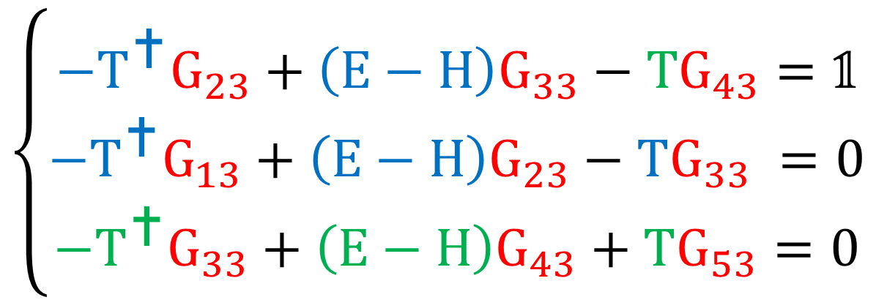
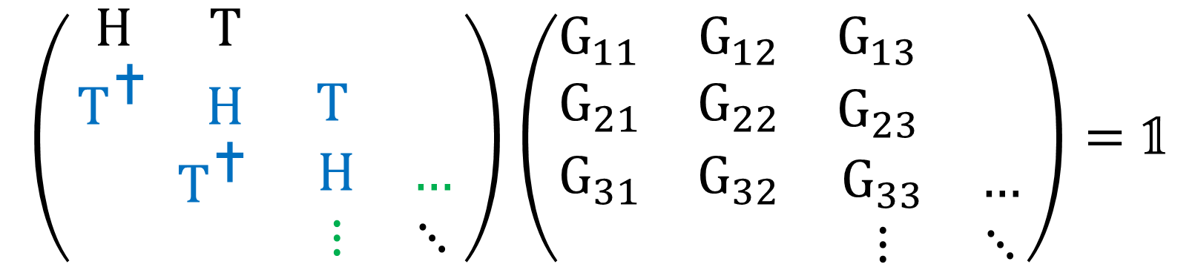
$$\left(\begin{matrix}\begin{matrix}H & T \\ T^{} & H\end{matrix} & \begin{matrix} & \\ T & \end{matrix} \\ \begin{matrix} & T^{} \\ & \end{matrix} & \begin{matrix}H & … \\ ⋮ & ⋱\end{matrix}\end{matrix}\right)\left(\begin{matrix}\begin{matrix}G_{11} & G_{12} \\ G_{21} & G_{22}\end{matrix} & \begin{matrix}G_{13} & \\ G_{23} & \end{matrix} \\ \begin{matrix}G_{31} & G_{32} \\ & \end{matrix} & \begin{matrix}G_{33} & … \\ ⋮ & ⋱\end{matrix}\end{matrix}\right)=𝟙$$
$$\left\{\begin{aligned}−T^{}G_{23}+\left(E−H\right)G_{33}−TG_{43}=𝟙 \\ −T^{}G_{13}+\left(E−H\right)G_{23}−TG_{33} =0 \\ −T^{}G_{33}+\left(E−H\right)G_{43}+TG_{53}=0\end{aligned}\right.$$
$$\left(E−(H+T^{}\frac{1}{E−H}T+T\frac{1}{E−H}T^{})\right)G_{33}−T^{}\frac{1}{E−H}TG_{13}−T\frac{1}{E−H}T^{}G_{53}=𝟙$$

Slide 5

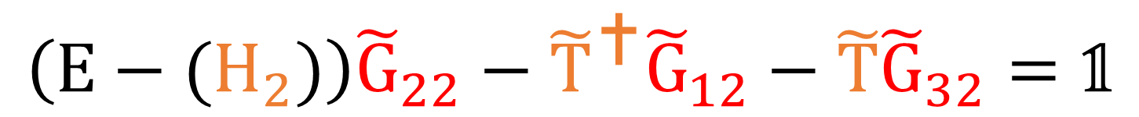
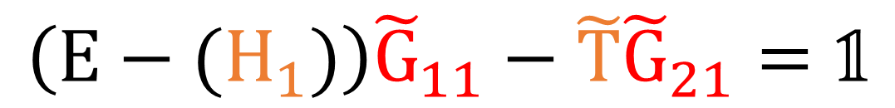
$$\left(E−(H+T\frac{1}{E−H}T^{})\right)G_{11}−T\frac{1}{E−H}TG_{31}=𝟙$$
$$\left(E−(H+T^{}\frac{1}{E−H}T+T\frac{1}{E−H}T^{})\right)G_{33}−T^{}\frac{1}{E−H}TG_{13}−T\frac{1}{E−H}T^{}G_{53}=𝟙$$
$$\left(E−(H_{1})\right){\tilde{G}}_{11}−\tilde{T}{\tilde{G}}_{21}=𝟙$$
$$\left(E−(H_{2})\right){\tilde{G}}_{22}−{\tilde{T}}^{}{\tilde{G}}_{12}−\tilde{T}{\tilde{G}}_{32}=𝟙$$

Slide 6
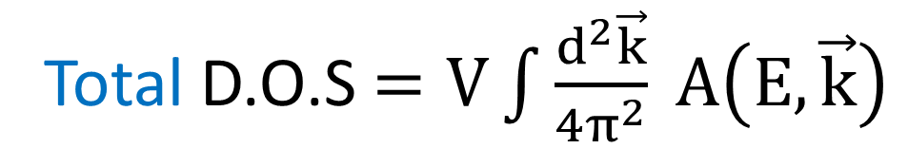
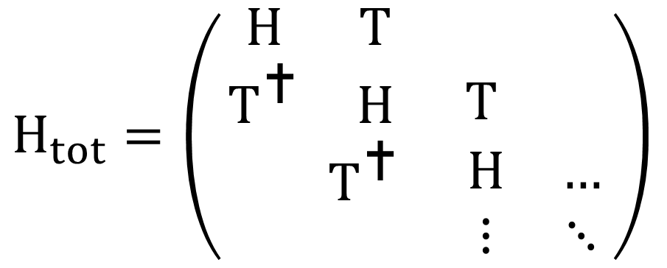


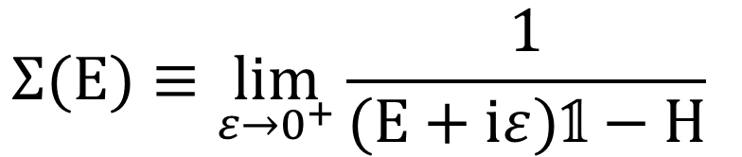
$$H_{tot}=\left(\begin{matrix}\begin{matrix}H & T \\ T^{} & H\end{matrix} & \begin{matrix} & \\ T & \end{matrix} \\ \begin{matrix} & T^{} \\ & \end{matrix} & \begin{matrix}H & … \\ ⋮ & ⋱\end{matrix}\end{matrix}\right)$$
$$H_{surf}(E)$$
$$H_{bulk}(E)$$
$$Σ(E)≡\lim_{ε→0^{+}}{\frac{1}{(E+iε)𝟙−H} }$$
Total Spectral Weight $A(E,\vec{k})=−\frac{1}{π}\lim_{ε→0^{+}}{Im(tr( G\left(E(\vec{k})+iε\right) )) }$
Total D.O.S $=V\int{\frac{d^{2}\vec{k}}{4π^{2}} A\left(E,\vec{k}\right) }$

Slide 7
You can find details in:
G. Grosso and G. Parravicini, Solid State Physics (Elsevier Science, 2000). 1st edition: ch 1.4 & ch 8.4
And papers on the github

